Slide 1
IT1102
Computer Hardware
Week 6
Introduction to User Account and Access Rights

Slide 2
User Accounts
A collection of information which include user privileges
Provide unique settings and preferences for users
Included to OS
  What files and folders a user can access
  What operations user can perform
    Read
    Write
    Delete
  What are the user’s personal preferences
    Desktop background
    Themes

Slide 3
Windows 7 User Accounts
Administrator account
Standard user Account
Guest account

Slide 4
Windows 7 User Accounts
Administrator account
  Able to perform actions that will affect other users
  Can change security settings
  Can Install and uninstall software and hardware
  Access all any file on the computer
  Change other account settings

Slide 5
Windows 7 User Accounts
Standard user Account
  Able in most of the capabilities of the computer,
  But permission need from an administrator for make changes that affect other users or the security of the computer.
  Can't install or uninstall software and hardware, delete files that are required for the computer to work, or change settings on the computer that affect other users.
  Most programs can run, but some programs might require you to provide an administrator password

Slide 6
Windows 7 User Accounts
Guest account
  Used to give temporary access to someone
  The guest account is not available on Windows 7 Starter
  Can't install software or hardware, change settings, or create a password

Slide 7

User Accounts
Control panel → User Accounts
  Create a new account
  Change an account
  Change the way user log on and logoff

Slide 8
Access Rights
Any permissions that have been assigned to a user on a computer resource.
Permission level | Description
Full control | Users can see the contents of a file or folder, change existing files and folders, create new files and folders, and run programs in a folder.
Modify | Users can change existing files and folders, but cannot create new ones.
Read and execute | Users can see the contents of existing files and folders and can run programs in a folder.
Read | Users can see the contents of a folder and open files and folders.
Write | Users can create new files and folders and make changes to existing files and folders.

Slide 9
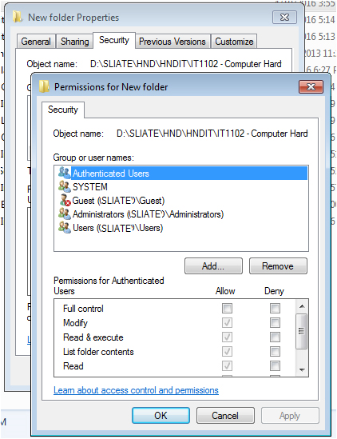
Set, view, change, or remove permissions on files and folders
Right-click the file or folder for which you want to set permissions, click Properties, and then click the Security tab.
Click Edit to open the Permissions dialog box.

Slide 10
Set, view, change, or remove permissions on files and folders
To change or remove permissions from an existing group or user, click the name of the group or user.
To set permissions for a group or user that does not appear in the Group or user names box, click Add. Type the name of the group or user you want to set permissions for, and then click OK.
To allow or deny a permission, in the Permissions for <User or Group> box, select the Allow or Deny check box.
When adding a new user or group, by default, this user or group will have Read & Execute, List Folder Contents, and Read permissions.

